Slide 1

Building Application With Ruby On Rails Framework
View Ruby On Rails course details at www.edureka.co/ruby-on-rails
For Queries:
Post on Twitter @edurekaIN: #askEdureka
Post on Facebook /edurekaIN
For more details please contact us:
US : 1800 275 9730 (toll free)
INDIA : +91 88808 62004
Email us : sales@edureka.co

Slide 2
Objectives
At the end of this module, you will be able to understand:
Introduction to Ruby on Rails Framework
Features of Ruby on Rails
MVC Architecture
Building Rails Application
Notes:
PRD layout, Understanding it's basic features, designing basic report containing graphical chart, Conditional Formatting, studying the PRPT file format, building a basic report in PDF report

Slide 3





9 Reasons Why You Should Learn Ruby
It is easy to learn
Saves time by writing more with less
Create web apps quickly and with ease
It is free of charge
Ruby can be customized

Slide 4





9 Reasons Why You Should Learn Ruby (Contd.)
It is Portable
Learning Ruby helps you get a job
DSL
Make your own Domain Specific Language
The community will help

Slide 5

History
Ruby released in 1993
It was designed by Yukihiro Matsumoto.
It’s mainly influenced by the predecessors Perl, Smalltalk, Eiffel, Ada and Lisp

Slide 6
Ruby – An Overview
Ruby is an Object Oriented Programming language
It is an interpreted language
Ruby draws from Smalltalk, Perl and Lisp
It treats everything as an object
Ruby has simple English like syntax
Using Ruby you will write less code

Slide 7

Ruby on Rails
Ruby on Rails is a full-stack framework
Used to developing web applications
It is working under the Model-View-Control pattern
It is an open source framework
Ruby on Rails framework is familiar for
Simplicity
Productivity
Speed of development
Reliable Solutions

Slide 8
Ruby on Rails – Reason behind the name
Ruby is the programming language used to implement the framework
The entire Rails Framework is written in Ruby
Rails is the framework that gives the necessary infrastructure
Ruby provides Simple Syntax and Productive coding
Ruby on Rails lets you write efficient web application using convention over conﬁguration

Slide 9

Ruby Versions
Ruby 2.2
Ruby 2.1
We will be using Ruby 2.1.6 in this course.
Ruby 2.0
Ruby 1.9
Ruby 1.8
Apr,
2015
Ruby 1.6
Dec, 2013
Feb ,
2013
Ruby 1.4
Dec,
2007
Ruby 1.2
Aug, 2003
Sept , 2000
Ruby 1.0
Aug ,
1999
Dec , 1997
Dec, 1996

Slide 10
Advantages
Ruby is a popular language in the league of Python, Perl, PHP
Ruby is Object-Oriented in the purest sense and has flexible Object model than any other languages
Its is available on Windows/Mac/Linux
Learning Ruby helps to work on Ruby on Rails, an open source web application framework that is used to create web applications
It also has a dynamic type system and automatic memory management
Notes:
The TIOBE index, which ranks the popularity and growth of programming languages.
MorPHA- The interaction, communication, cooperation between humans and intelligent Robot assistants. The research project was completed successfully in June 2003.
Alcatel-Lucent is at the forefront of global communications, providing products and innovations in IP and cloud networking, as well as ultra-broadband fixed and wireless access, to service providers, enterprises and institutions throughout the world.
Basecamp, a web-based project management application developed by37signals, is programmed entirely in Ruby.
43 Things allows you to keep a list of goals and share it with the world. It was developed entirely in Ruby.
A List Apart, a magazine for people who make websites that has been around since 1997, has recently been revamped and uses a custom application built with Ruby on Rails.
Blue Sequence, a sophisticated mission-critical application which forms part of Toyota Motor Manufacturing’s own “sequence-in-time” production process, has recently been selected as finalist the British Computer (BCS) Information Management Awards.
he Metasploit Framework, a community open source project managed by Rapid7, is a free penetration testing platform that helps IT professionals assess the security of their networks and applications. The Metasploit Project consists of over 700,000 lines of code and has been downloaded over a million times in 2010. The commercial editionsMetasploit Express and Metasploit Pro developed by Rapid7 are also based on Ruby.

Slide 11





Examples of Application built on Ruby on Rails

Slide 12
Rails Golden Rules
Convention over configuration(COC)
COC means that the developer should only be specifying unconventional aspects of the application. Ruby on Rails conventions guides you to less code and less repetition
Don’t Repeat Yourself (DRY)
DRY means that information can be found in a single and common location, where the developer can reuse the code

Slide 13
Rails Architecture
Rails applications are implemented using the Model-View-Controller (MVC)
Model will be denoted as ActiveRecord
Back end Database and Tables will be handled by ActiveRecord
View will be denoted as ActionView
HTML and Front end tools will be handled by ActionView
Controller will be denoted as ActionController
Request and responses will be handled by ActionController

Slide 14
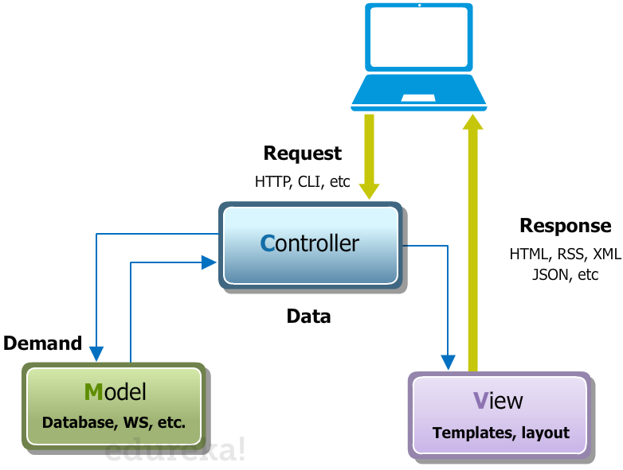
MVC Architecture

Slide 15
Creating a Rails Application
Rails application can be created using the following command
>rails new app_name
When you create an application using the rails helper script, you can see that a new directly structure is created for your application. The directory structure will have to following directories that will be explained in the next slide.

Slide 16
Directory Layout
File /Folder | Purpose
app/ | Contains the controllers, models, views, helpers, mailers and assets for your application.
bin/ | Contains the rails script that starts your app and can contain other scripts you use to deploy or run your application.
config/ | Configure your application's routes, database, and more
condig.ru | Rack configuration for Rack based servers used to start the application.
db/ | Contains your current database schema, as well as the database migrations
Gemfile Gemfile.lock | These files allow you to specify what gem dependencies are needed for your Rails application. These files are used by the Bundler gem.
Lib/ | Extended modules for you application
Log/ | Application log files

Slide 17
Directory Layout (Contd.)
File /Folder | Purpose
public/ | The only folder seen by the world as-is. Contains static files and compiled assets.
Rakefile | This file locates and loads tasks that can be run from the command line. Rather than changing Rakefile, you should add your own tasks by adding files to the lib/tasks directory of your application
README.rdoc | This is a brief instruction manual for your application. You should edit this file to tell others what your application does, how to set it up, and so on.
test/ | Unit tests, fixtures, and other test apparatus.
tmp/ | Temporary files (like cache, pid, and session files).
Vendor/ | A place for all third-party code. In a typical Rails application this includes vendor’s gems.

Slide 18
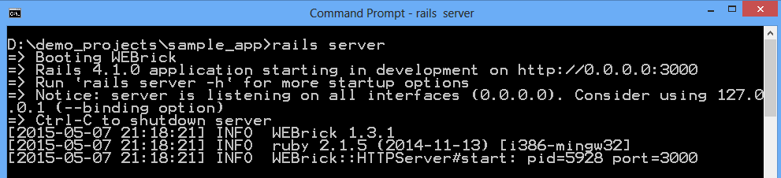
Running Rails Application
Rails application can be booted using the following command
>rails server
This command will fire up WEBrick, a web server distributed with Ruby.
Default environment is development
Default port is 3000
http://127.0.0.1:3000

Slide 19
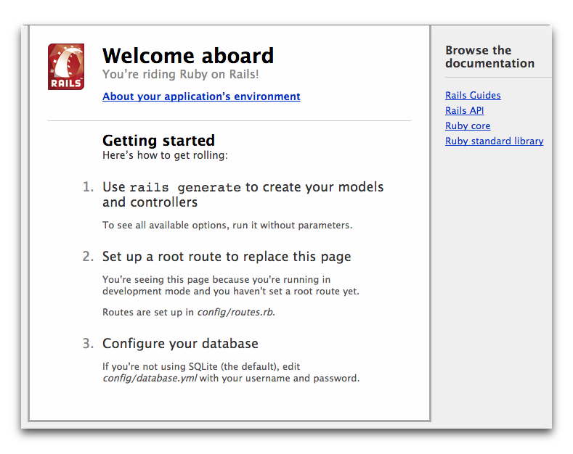
Running Rails Application (Contd.)
To see your application in action, open a browser window and navigate to http://localhost:3000

Slide 20
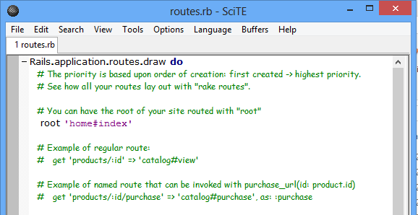
Creating Rails Views and Controller
Create first controller
>rails generate controller home
Create new file and store with name index.html.erb
>rails g controller home index
Add the content to index.html.erb file
<h1>Hello, Rails!</h1>
Open the file config/routes.rb in your editor. Remove the comment “#” and change root to
# root ‘home#index'

Slide 21
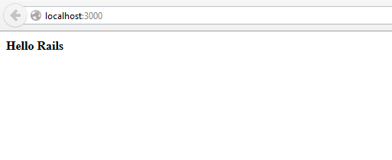
Creating Rails Views and Controller (Contd.)
Launch the web server again and navigate to http://localhost:3000 in your browser.

Slide 22

For Queries:
Post on Twitter @edurekaIN: #askEdureka
Post on Facebook /edurekaIN

